Slide 1

ON-LINE ANALYTICAL PROCESSING
Dr. Yashvardhan Sharma
Department of Computer Science & Information Systems
BITS, Pilani
L12

Slide 2
Lattice of Cuboids
all
0-D(apex) cuboid
time
item
location
supplier
1-D cuboids
time,item
time,location
item,location
location,supplier
2-D cuboids
time,supplier
item,supplier
time,item,location
time,location,supplier
3-D cuboids
time,item,supplier
item,location,supplier
4-D(base) cuboid
time, item, location, supplier

Slide 3
CUBE
Multi-dimensional cube:
Fact table view:
day 2
day 1
dimensions = 3

Slide 4
Aggregates
Add up amounts for day 1
In SQL: SELECT sum(amt) FROM SALE
WHERE date = 1
81

Slide 5
Aggregates
Add up amounts by day
In SQL: SELECT date, sum(amt) FROM SALE
GROUP BY date

Slide 6
Aggregates
Operators: sum, count, max, min, median, ave
“Having” clause
Using dimension hierarchy
  average by region (within store)
  maximum by month (within date)

Slide 7
Cube Aggregation
Example: computing sums
day 2
. . .
day 1
129
rollup
drill-down

Slide 8
Cube Operators
day 2
. . .
day 1
sale(c1,*,*)
129
sale(c2,p2,*)
sale(*,*,*)
sale(*,p1,*)

Slide 9
Extended Cube
*
day 2
sale(*,p2,*)
day 1

Slide 10
Aggregation Using Hierarchies
day 2
customer
day 1
region
country
(customer c1 in Region A;
customers c2, c3 in Region B)

Slide 11
Pivoting
Fact table view:
Multi-dimensional cube:
day 2
day 1

Slide 12
Cube Aggregates Lattice
129
all
city
product
date
city, product
city, date
product, date
use greedy
algorithm to
decide what
to materialize
city, product, date
day 2
day 1

Slide 13
Dimension Hierarchies
all
state
city

Slide 14
Dimension Hierarchies
all
city
product
date
city, product
city, date
product, date
state
city, product, date
state, date
state, product
state, product, date
not all arcs shown...

Slide 15
Interesting Hierarchy
all
years
weeks
quarters
months
conceptual
dimension table
days

Slide 16
SAMPLE CUBE
Date
Total annual sales
of TV in U.S.A.
1Qtr
2Qtr
3Qtr
4Qtr
sum
Product
TV
Total annual sales
of PC in U.S.A.
PC
U.S.A
VCR
Total sales
In U.S.A
Total annual sales
of VCR in U.S.A.
Total Q1 sales
In U.S.A
sum
Canada
Total sales
In Canada
Country
Total Q1 sales
In Canada
Mexico
Total Q1 sales
In Mexico
Total sales
In Mexico
sum
Total Q2 sales
In all countries
TOTAL SALES
Total Q1 sales
In all countries
All, All, All

Slide 17
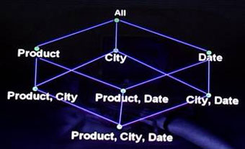
Suppose if we have 3 dimensions product, City and Date. We consider these as our 3 elements which are nothing but the perspectives or dimensions. If we take these, then we have 3 sets of 2 element combinations {Product, City}, {Product, Date} and also {Date, City} and also contains the 3 element set {Product, City, Date} which forms a lattice of cuboids. Once we have 2 dimensional computations we can as well compute total sales for each product over all cities and over all dates. Using one dimensional cuboid we can compute grand sales over all products, over all cities and over all dates. If you observe the ‘all’ the grand sales and the base cuboid, the base cuboid is the greatest lower bound and apex cuboid is the least upper bound.
That is why a cube is nothing but a collection of cuboids, and each cuboid is nothing but a aggregation. If we integrate one dimensional, two dimensional and three dimensional aggregations then that is a data cube.

Slide 18
Conceptual vs. Actual
The “cube” is a logical way of visualizing the data in an OLAP setting
Not how the data is actually represented on disk
Two ways of storing data:
  ROLAP: Relational OLAP
  MOLAP: Multidimensional OLAP

Slide 19
OLAP & CUBE
Construction of the data cube is key to the operation of OLAP
The computation process creates a set of aggregates on the various dimensions of the data
The CUBE operator

Slide 20
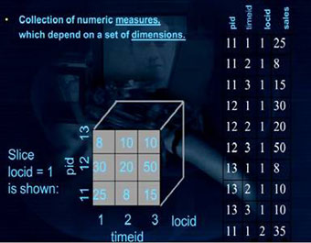

Slide 21
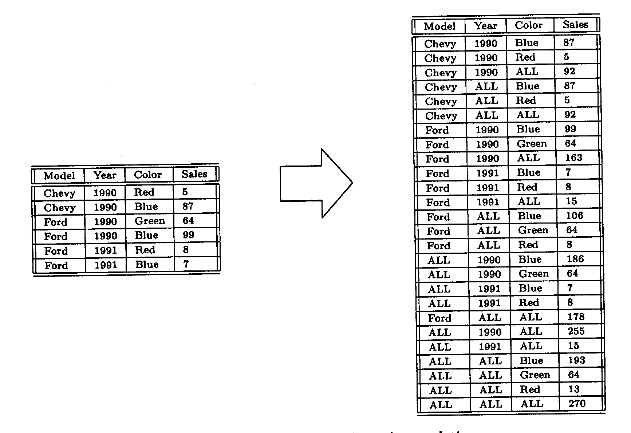
An example of the CUBE Operator

Slide 22
Cube Operator
Locid | City | State | Country
1 | Madison | WI | USA
2 | Fresno | CA | USA
5 | Chennai | TN | India
pid | timeid | Locid | sales
11 | 1 | 1 | 25
11 | 2 | 1 | 8
11 | 3 | 1 | 15
12 | 1 | 1 | 30
12 | 2 | 1 | 20
12 | 3 | 1 | 50
13 | 1 | 1 | 8
13 | 2 | 1 | 10
13 | 3 | 1 | 10
11 | 1 | 2 | 35
11 | 2 | 2 | 22
11 | 3 | 2 | 10
12 | 1 | 2 | 26
12 | 2 | 2 | 45
12 | 3 | 2 | 20
13 | 1 | 2 | 20
13 | 2 | 2 | 40
13 | 3 | 2 | 5
Pid | Pname | category | Price
11 | Lee Jeans | Apparel | 25
12 | Zord | Toys | 18
13 | Biro Pen | Stationery | 2
Timeid | Date | Month | Year | Holiday
1 | 10/11/95 | Nov | 1995 | N
2 | 11/11/96 | Nov | 1996 | N
3 | 12/11/97 | Nov | 1997 | N

Slide 23
Cube Operator
Select T.year, L.state, SUM (sales)
from Sales S, Times T, Locations L
Where S.timeid=T.timeid & S.locid=L.locid
Group By T.year, L.state
 | WI | CA | Total
1995 | 63 | 81 | 144
1996 | 38 | 107 | 145
1997 | 75 | 35 | 110
Total | 176 | 223 | 399
Select T.year, SUM (sales)
from Sales S, Times T
Where S.timeid=T.timeid
Group By T.year
Select SUM (sales)
from Sales S, Locations L
Where S.locid=L.locid
OR
Select L.state, SUM (sales)
from Sales S, Locations L
Where S.locid=L.locid
Group By L.state
Select SUM (sales)
from Sales S, Time T
Where S.timeid=T.timeid
How many such SQL queries to build cross-tab?

Slide 24
Cube Operator
Select T.year, L.state, SUM (sales)
from Sales S, Times T, Locations L
Where S.timeid=T.timeid & S.locid=L.locid
Group By CUBE (T.year, L.state)
T.Year | L.State | SUM(sales)
1995 | WI | 63
1995 | CA | 81
1995 | All | 144
1996 | WI | 38
1996 | CA | 107
1996 | All | 145
1997 | WI | 75
1997 | CA | 35
1997 | All | 110
All | WI | 176
All | CA | 223
All | All | 399
 | WI | CA | Total
1995 | 63 | 81 | 144
1996 | 38 | 107 | 145
1997 | 75 | 35 | 110
Total | 176 | 223 | 399

Slide 25
Rollup Operator
Select T.year, L.state, SUM (sales)
from Sales S, Times T, Locations L
Where S.timeid=T.timeid & S.locid=L.locid
Group By ROLLUP (T.year, L.state)
T.Year | L.State | SUM(sales)
1995 | WI | 63
1995 | CA | 81
1995 | All | 144
1996 | WI | 38
1996 | CA | 107
1996 | All | 145
1997 | WI | 75
1997 | CA | 35
1997 | All | 110
All | All | 399
 | WI | CA | Total
1995 | 63 | 81 | 144
1996 | 38 | 107 | 145
1997 | 75 | 35 | 110
Total | 176 | 223 | 399
Find out what the following SQL will generate?
Select T.year, L.state, SUM (sales)
from Sales S, Times T, Locations L
Where S.timeid=T.timeid & S.locid=L.locid
Group By ROLLUP (L.state, T.year)

Slide 26
The CUBE Operator
Proposed by Gray et al*
Effectively involves a series of GROUP-BY operations to aggregate data
Creates power set on all attributes according to:
  A measure
  An aggregator function
*J. Gray, S. Chaudhuri, A. Bosworth, A. Layman,D. Reichart, M. Venkatrao, F. Pellow and H. Pirahesh.
Data cube: A relational aggregation operator generalizing group-by, cross-tab and sub-totals.
Data Mining and Knowledge Discovery, 1:29-54, 1997.

Slide 27
CUBING Problem
Problem: this generates a lot of data and work (2^{n} sets in total, where n is the number of dimensions)
Solution: optimized algorithms to run faster, consume less memory, and perform fewer I/Os.

Slide 28
Efficient Computation of Data Cubes
  ROLAP-based cubing algorithms (Agarwal et al’96)
  Array-based cubing algorithm
  (Zhao et al’97)
S. Agarwal, R. Agrawal, P. M. Deshpande, A.Gupta, J. F. Naughton, R. Ramakrishnan and S.Sarawagi.
On the computation of multidimensional aggregates. In VLDB'96.
Y. Zhao, P. M. Deshpande, and J. F. Naughton.
An array-based algorithm for simultaneous multidimensional aggregates. In SIGMOD'97.

Slide 29
Approaches to OLAP Servers
It is all about which DBMS you choose to store your data warehouse data
RDBMS – ROLAP
MDDB – MOLAP
BOTH - HOLAP

Slide 30
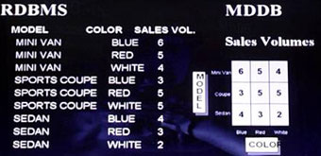

Slide 31
OLAP Flavours
OLAP
ROLAP
MOLAP
DOLAP
HOLAP

Slide 32
Approaches to OLAP Servers
Three possibilities for OLAP servers
(1) Relational OLAP (ROLAP)
  Relational and specialized relational DBMS to store and manage warehouse data
  OLAP middleware to support missing pieces
(2) Multidimensional OLAP (MOLAP)
  Array-based storage structures
  Direct access to array data structures
(3) Hybrid OLAP (HOLAP)
  Storing detailed data in RDBMS
  Storing aggregated data in MDBMS
  User access via MOLAP tools

Slide 33
ROLAP
Special schema design: star, snowflake
Special indexes: bitmap, multi-table join
Proven technology (relational model, DBMS), tend to outperform specialized MDDB especially on large data sets
Products
  IBM DB2, Oracle, Sybase IQ, RedBrick, Informix

Slide 34
ROLAP
Defines complex, multi-dimensional data with simple model
Reduces the number of joins a query has to process
Allows the data warehouse to evolve with relatively low maintenance
Can contain both detailed and summarized data.
ROLAP is based on familiar, proven, and already selected technologies.
BUT!!!
SQL for multi-dimensional manipulation of calculations.

Slide 35
MOLAP
MDDB: a special-purpose data model
Facts stored in multi-dimensional arrays
Dimensions used to index array
Sometimes on top of relational DB
Products
  Pilot, Arbor Essbase, Gentia

Slide 36
MOLAP
Pre-calculating or pre-consolidating transactional data improves speed.
BUT
Fully pre-consolidating incoming data, MDDs require an enormous amount of overhead both in processing time and in storage. An input file of 200MB can easily expand to 5GB
MDDBs are great candidates for the < 100GB department data marts.
With MDDs, application design is essentially the definition of dimensions and calculation rules, while the RDBMS requires that the database schema be a star or snowflake.

Slide 37
MOLAP vs. ROLAP
 | MOLAP Choice for faster response & more complex queries
ROLAP
Query Performance
Complexity Of Analysis

Slide 38
MOLAP vs. ROLAP
Data Storage | Underlying Technologies | Functions & Features
Data Stored as Relational Tables in DW Detailed & light summary data available Very large data volumes | Use of complex SQL ROLAP engine in analytical server creates data cubes on the fly Multidimensional views by presentation layer | Known environment and availability of many tools Limitations on complex analysis functions Drill-through easy but not drill-across
Data srored as relational tables in DW Summary data kept in MDDBs Moderate data volumes Summary data access from MDDB and detailed data from DW | creation of pre-fabricated cubes by MLAP engine. Proprietary technology to store multidimensional views in arrays. High speed data matrix retrieval Sparse matrix handling techniques to manage data sparsity in summaries | Faster access Large library of functions for complex calculations Easy analysis irrespective of the number of dimensions Excessive drill-down and slice and dice capabilities
ROLAP
MOLAP

Slide 39
HOLAP
HOLAP technologies attempt to combine the advantages of MOLAP and ROLAP. For summary-type information, HOLAP leverages cube technology for faster performance. When detail information is needed, HOLAP can "drill through" from the cube into the underlying relational data.

Slide 40
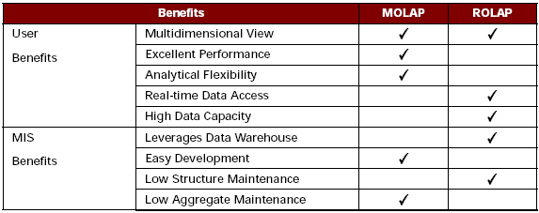
ROLAP vs. MOLAP

Slide 41
ROLAP vs. MOLAP
1) Performance:
    How fast will the system appear to the end-user?
    MDD server vendors believe this is a key point in their favor.
  2) Data volume and scalability:
    While MDD servers can handle up to 100GB of storage, RDBMS servers can handle hundreds of gigabytes and terabytes.

Slide 43
OLAP Models
MOLAP :
  Multidimensional data storage
  Pre-calculated and prefabricated multi-dimensional data cubes are stored in MDDBs
  MOLAP engine is used to push multidimensional view of the data from MDDBs to user

Slide 44
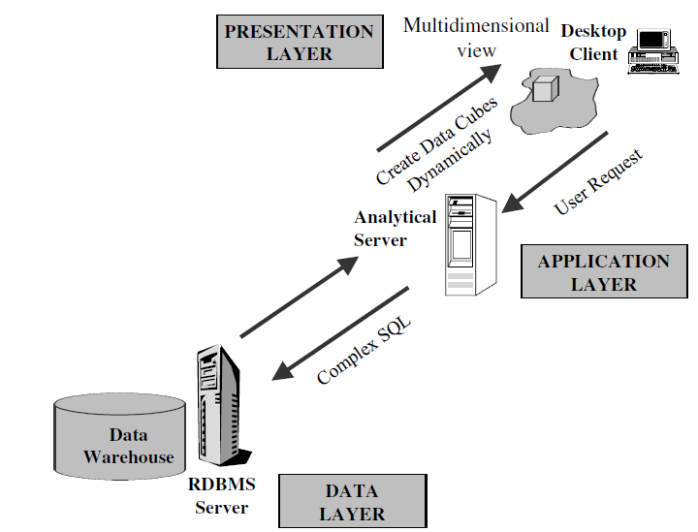
OLAP Models
ROLAP :
  Use of Relational database
  Complex multi-dimensional view based user queries are transformed into complex SQL queries directed to RDBMS
  Multidimensional view of the data created on the fly by analytical server

Slide 45
Hybrid OLAP - HOLAP
  Best of both worlds
  Storing detailed data in RDBMS
  Storing aggregated data in MDBMS
  User access via MOLAP tools

Slide 46
HOLAP
RDBMS Server
MDBMS Server
Client
Multi-dimensional access
SQL-Read
Multidimensional Viewer
User
data
Meta data
Multi-
dimensionaldata
Derived
data
SQL-Reach Through
Relational
Viewer
SQL-Read

Slide 47
ROLAP, MOPAL, or HOLAP
IF
A. You require write access
B. Your data is under 50 GB
C. Your timetable to implement is 60-90 days
D. Lowest level already aggregated
E. Data access on aggregated level
F. You’re developing a general-purpose application for inventory movement or assets management
THEN
Consider an MDD /MOLAP solution for your data mart
IF
A. Your data is over 100 GB
B. You have a "read-only" requirement
C. Historical data at the lowest level of granularity
D. Detailed access, long-running queries
E. Data assigned to lowest level elements
THEN
Consider an RDBMS/ROLAP solution for your data mart.
IF
A. OLAP on aggregated and detailed data
B. Different user groups
C. Ease of use and detailed data
THEN
Consider an HOLAP for your data mart

Slide 48
Conclusions
ROLAP: RDBMS -> star/snowflake schema
MOLAP: MDDB -> Cube structures
ROLAP or MOLAP: Data models used play major role in performance differences
MOLAP: for summarized and relatively lesser volumes of data (100GB)
ROLAP: for detailed and larger volumes of data
Both storage methods have strengths and weaknesses
The choice is requirement specific, though currently data warehouses are predominantly built using RDBMSs/ROLAP.
HOLAP is emerging as the OLPA server of choice

